Slide 1
React behind the scenes
React Study Group– Daniel torres orjuela
07/2023

Slide 2

Definición, ventajas y desventajas
Componentes, JSX y transpiladores
Estado y manejadores de eventos
React behind the scenes
Mejores prácticas

Slide 3




Chill and have fun
Ask all the questions you want, the idea is to debate… and learn

Slide 4
1
The classic web development approach
Agenda
2
The React approach
3
Three step rendering process
4
State as a snapshot
5
The React state changes queue

Slide 5







The web development classic approach
Browser

Slide 6
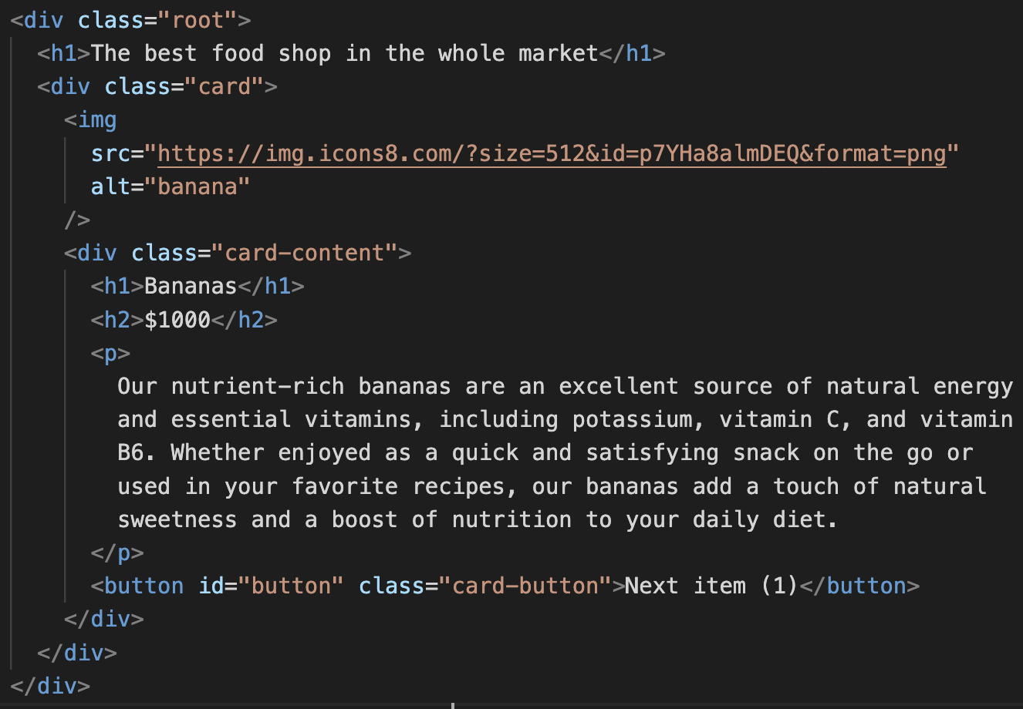
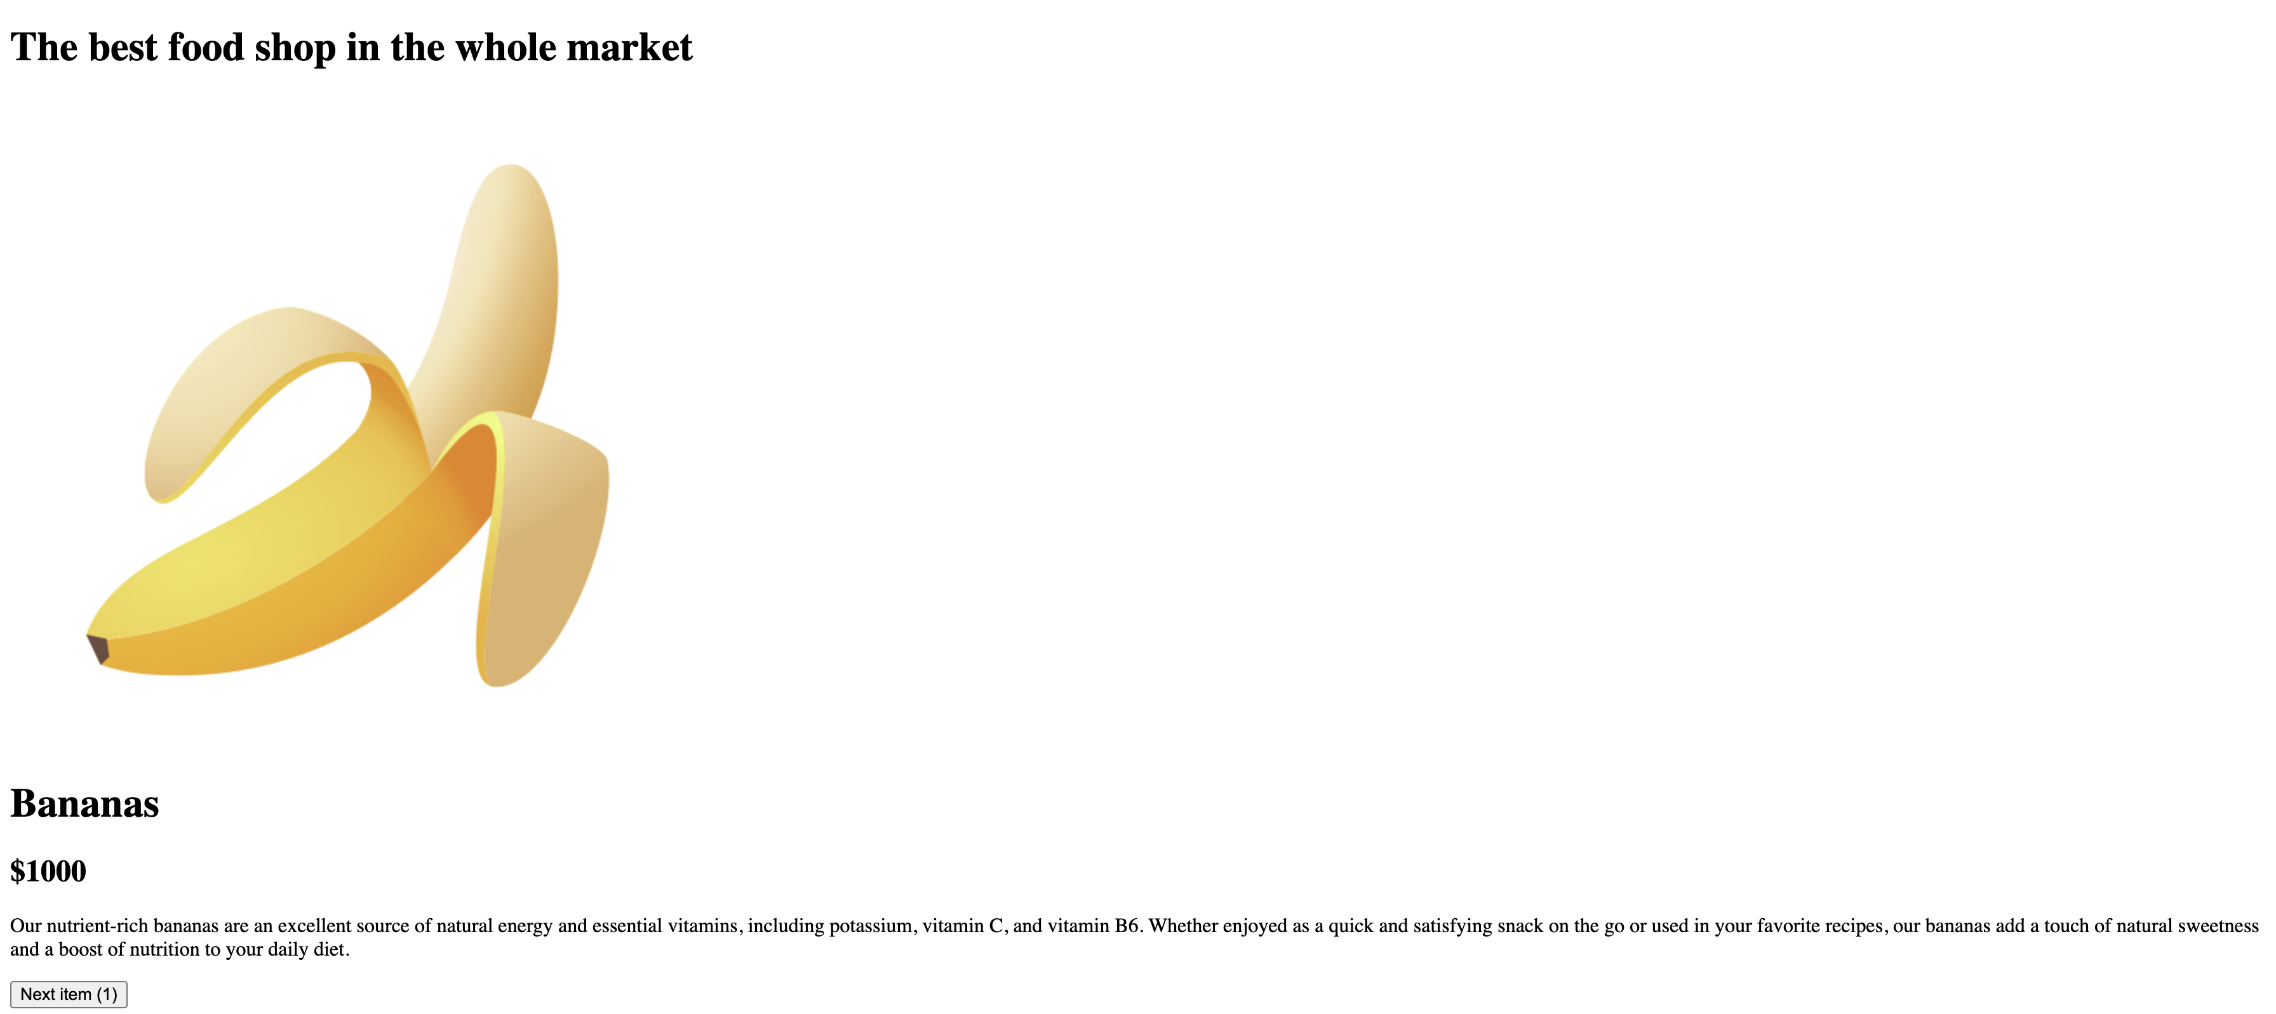
The web development classic approach

Slide 7
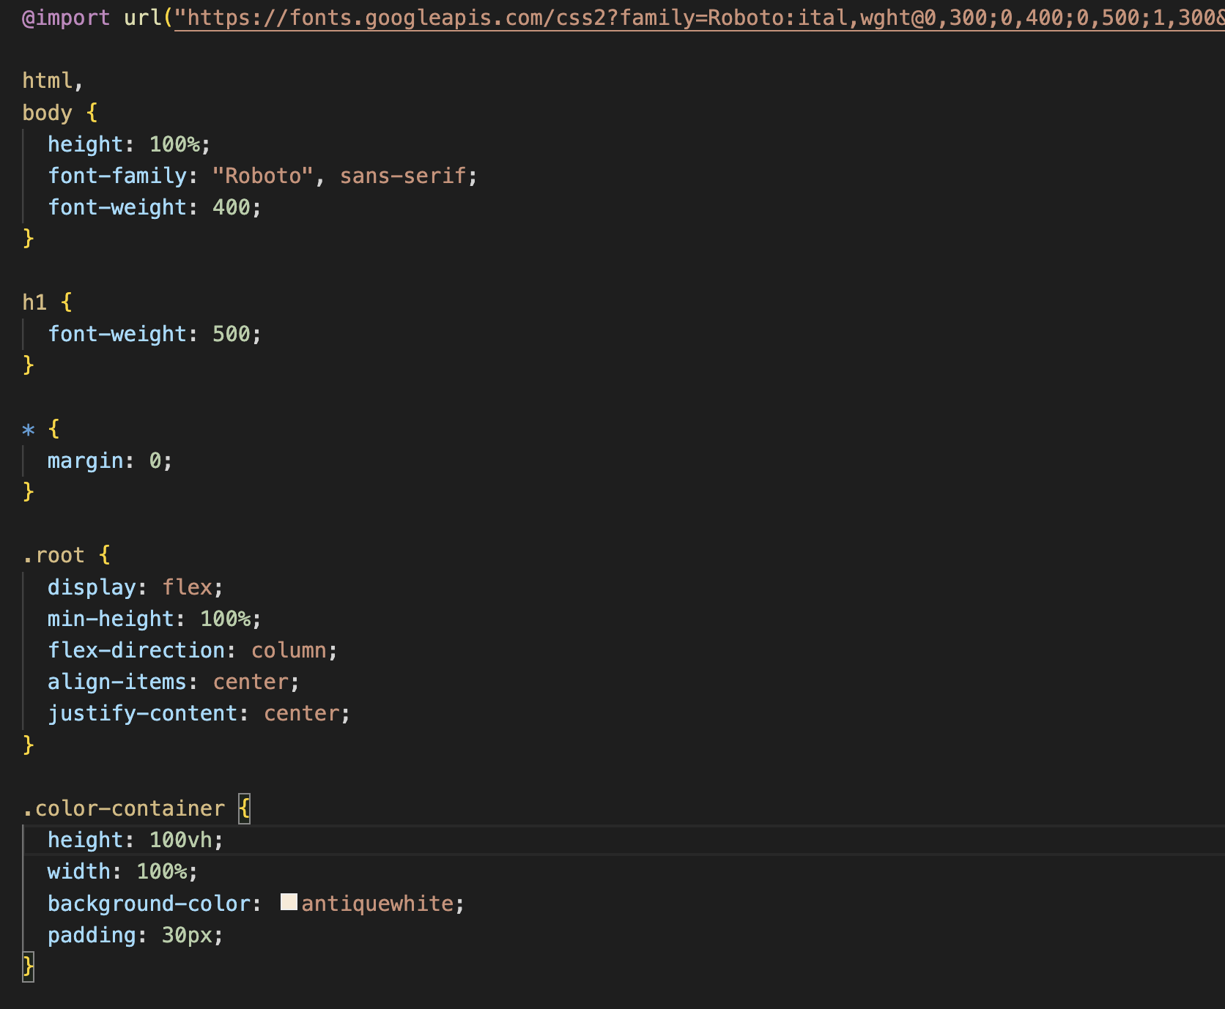
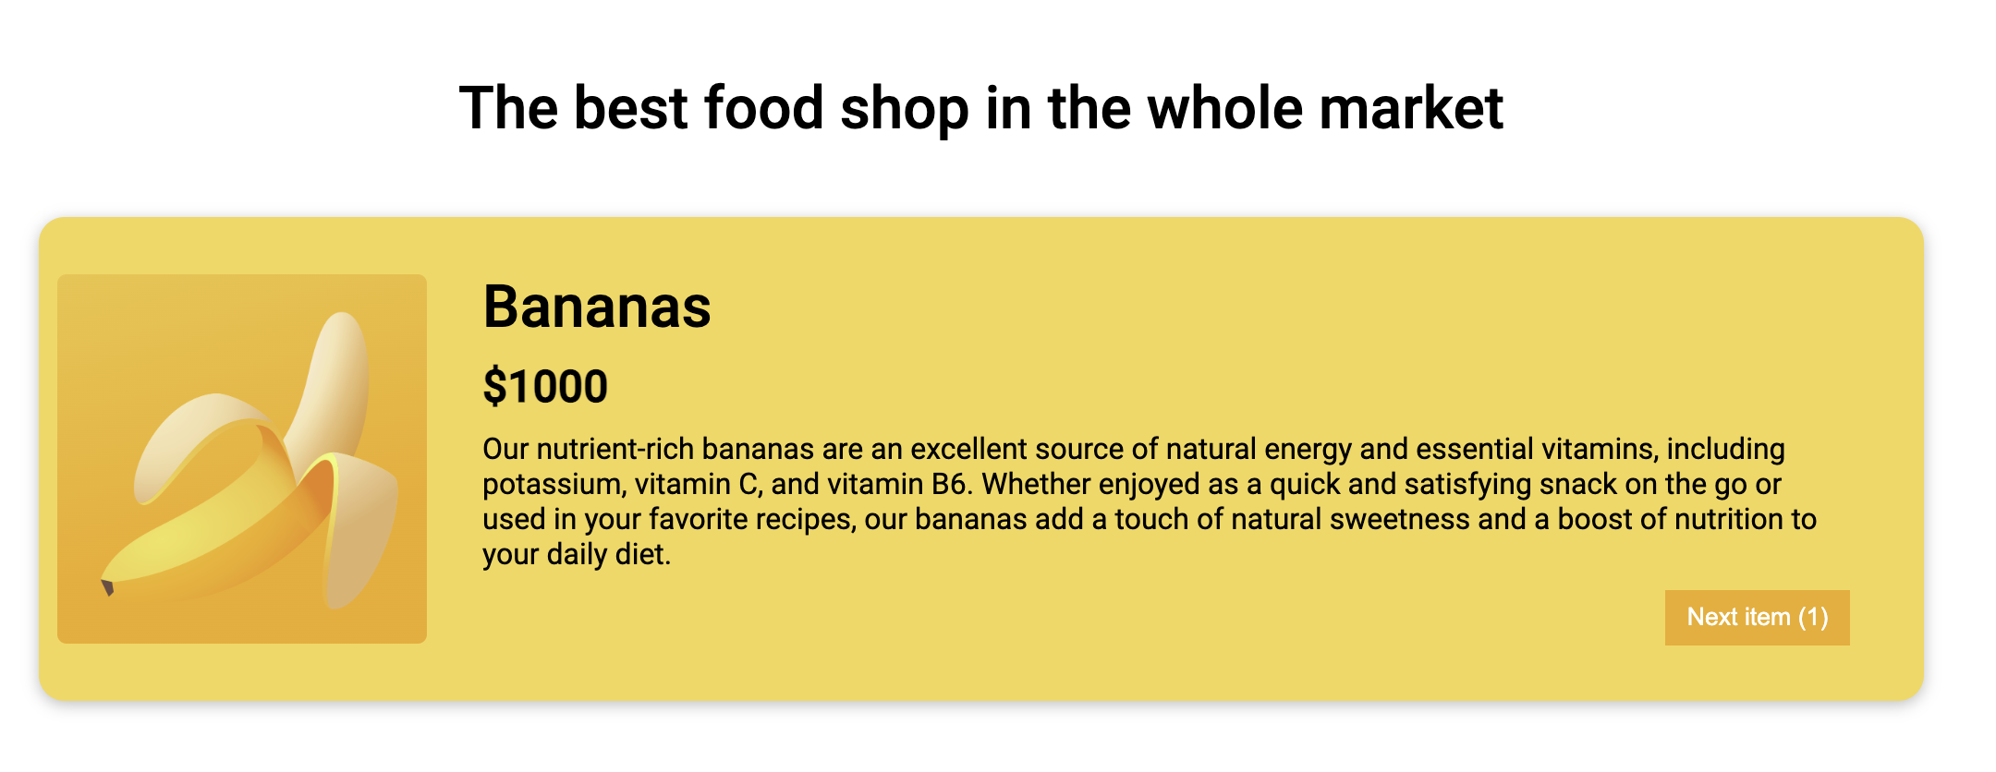
The web development classic approach

Slide 8
The classic approach| DOM API
Document
Object
Model

Slide 9
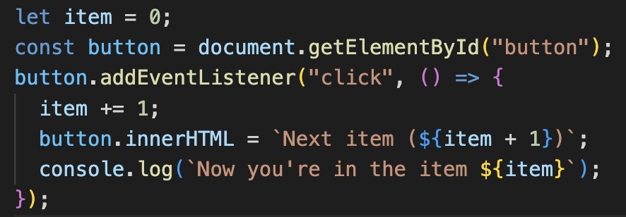
The classic approach | DOM API
Document
Object
Model

Slide 10

The React Approach

Slide 11

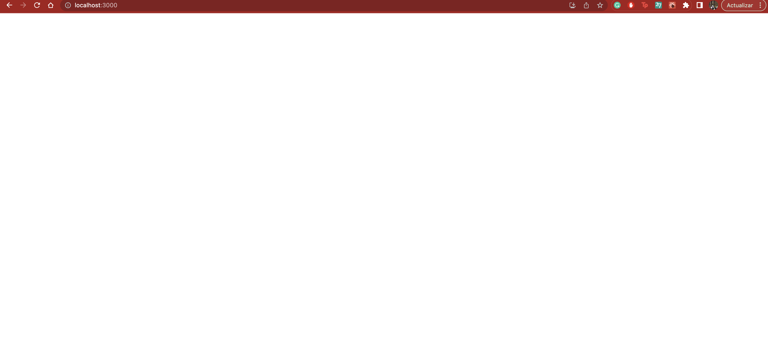
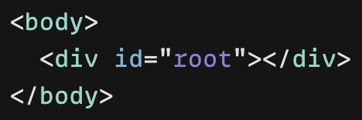
The React Approach

Slide 12
The React Approach
< div />
DOM API

Slide 13

The React Approach
< div />
Virtual DOM
DOM API
Rendering process
Executed due to the init of the app or a change in any component’s state

Slide 14
React rendering process
Triggering
Rendering
Commiting
Causes
What happens?
What happens?
First render
The app’s initialization
The root component is called
The necessary DOM nodes are created in the virtual DOM and state is associated
The appendChild method is called for every new node so elements are added to the DOM
What happens?
A root element is created in the virtual DOM
Re-renders
Causes
What happens?
What happens?
The change of a component’s state
The component which state changed is called (and its children) DOM changes are calculated
The calculated changes are applied to the DOM
setState, context and props cause those changes

Slide 15
React rendering process | First render
Triggering
Rendering
Commiting
Causes
What happens?
What happens?
The app’s initialization
The root component is called
The necessary DOM nodes are created in the virtual DOM and state is associated
The appendChild method is called for every new node so elements are added to the DOM
What happens?
A root element is created in the virtual DOM

Slide 16
First render | Triggering
A root element is created in the virtual DOM
<div />
root

Slide 17
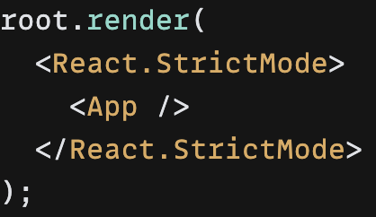
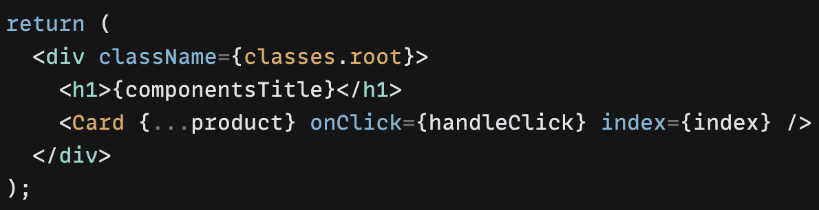
First render | rendering
As the root component is renderer, the whole app is executed.
React calculates the virtual DOM based on the returned JSX and state
<div />
root
<div />
<div />
<h1 />
App.jsx
img
div
div
App.jsx
h1
h2
p
button

Slide 18
First render | rendering
<div />
root
<div />
<div />
<h1 />
img
div
div
Which are the state variables of the red div and what value do they have when the app is initialized?
h1
h2
p
button

Slide 19
First render | Commiting
The DOM API is changed based on the state of the Virtual DOM for the initial render
<div />
<div />
root
root
<div />
<div />
Index: 0
<div />
<h1 />
<div />
<h1 />
img
div
div
img
div
div
h1
h2
p
button
h1
h2
p
button

Slide 20
React rendering process | Re-renders
Triggering
Rendering
Commiting
Causes
What happens?
What happens?
The change of a component’s state
The component which state changed is called (and its children) DOM changes are calculated
The calculated changes are applied to the DOM
setState, context and props cause those changes

Slide 21
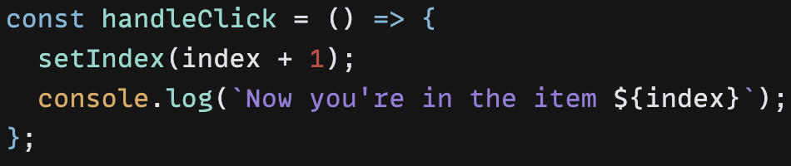
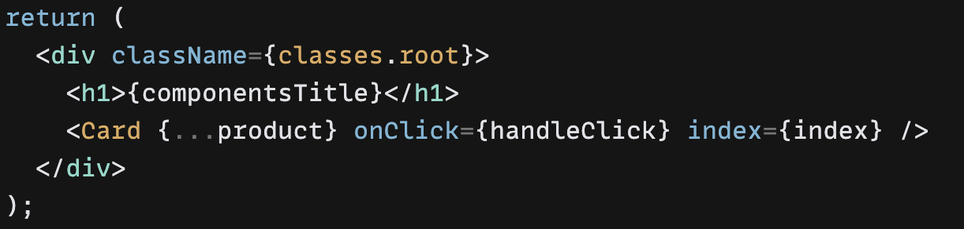

Re-renders | Triggering
A component’s state changed, this process triggers a new render with the new state
Handle click is executed, so the index state variable changes
The component is executed again with it’s new state
App.jsx
App.jsx
<div />
Index: 0
<div />
Index: 1

Slide 22
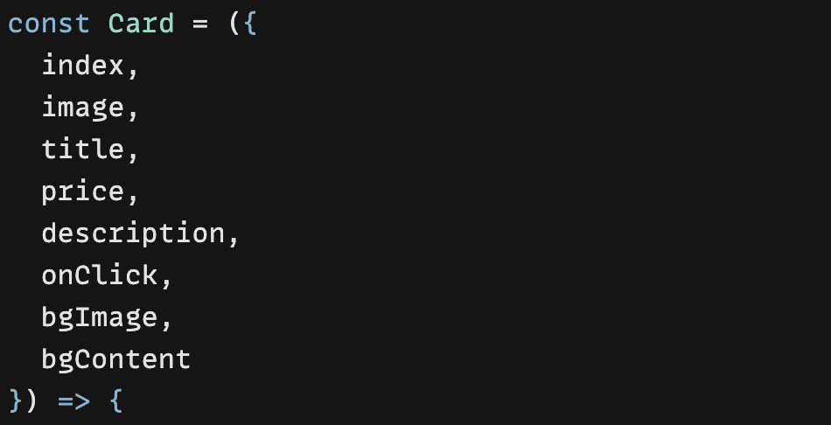
Re-renders | Triggering
A component’s state changed, this process triggers a new render with the new state
The component is executed again with it’s new state
As the component is executed, its children are executed too (their props have changed)
Card.jsx
App.jsx

Slide 23
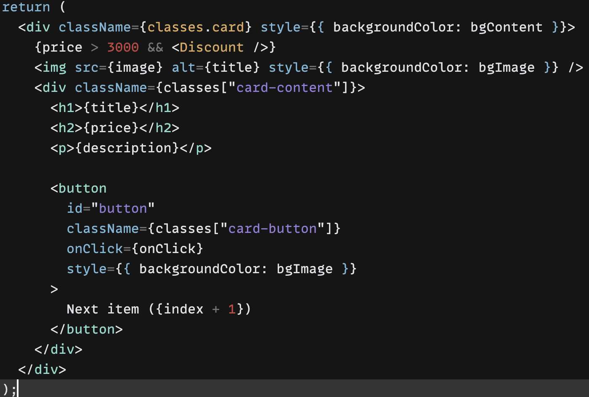
Re-renders | rendering
Each render is a snapshot.
<div />
root
<div />
Index: 1
<div />
<h1 />
img
div
div
h1
h2
p
button

Slide 24


Re-renders | rendering
Different states should return different results
Index: 1
Index: 2
<div />
<div />
<div />
<div />
<div />
<h1 />
<div />
<h1 />
img
div
div
img
div
div
h1
h2
p
button
h1
h2
p
button

Slide 25




Re-renders | rendering
React is based on functional components. Those components must be pure.
It’s like ordering food in a restaurant!
Index: 1
Index: 3
Index: 245

Slide 26
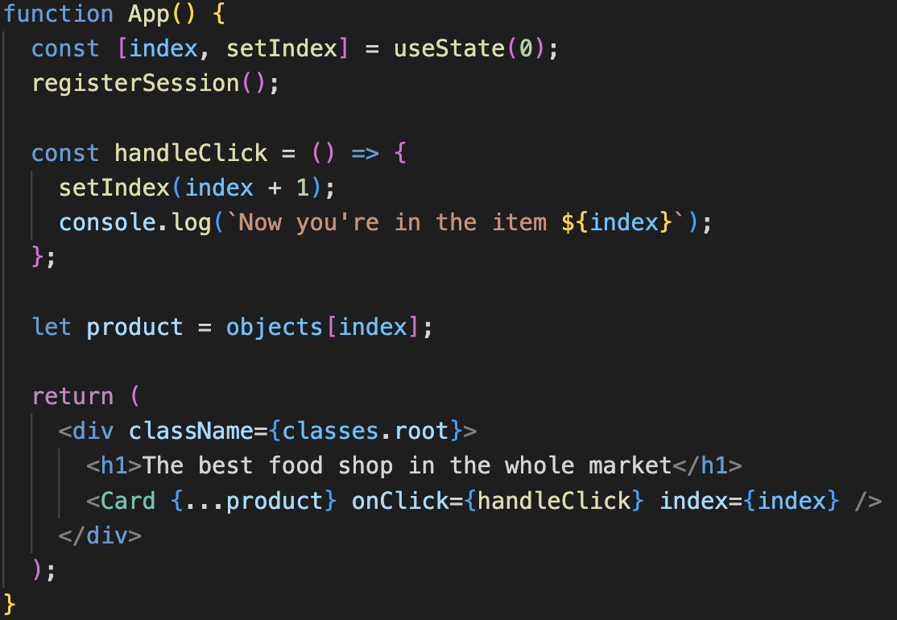
Re-renders | rendering
We want to execute the registerSession() method once per user’s session. There’s an approach for that… do you think it’ll work?

Slide 27
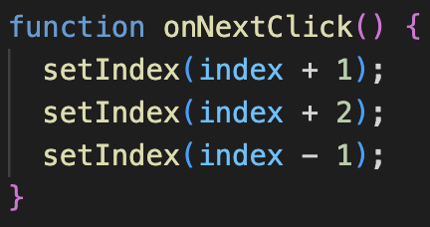
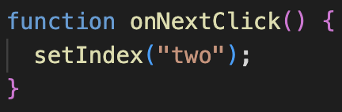
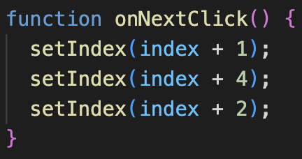
Re-renders | rendering
Now the market’s owner wants us to add a “Next item” button outside the card that shows only the even index items. Which function accomplish that?

Slide 28
React makes a queue of the state changes it’ll do
Reacts first takes all the changes and add them to the queue, once there is no change left, it executes them all according to the “given instructions”
Assigning a direct value to the setIndex is like saying “hey, it doesn’t matter what value it has, reset it to this one”

Slide 29
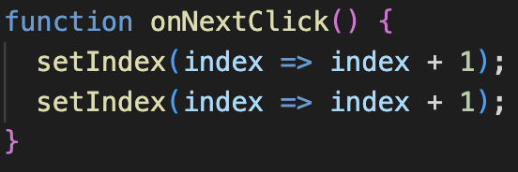
React makes a queue of the state changes it’ll do
If we want to make operations in state variables on a single render, we must use a function that takes the actual value as parameter and returns the expected result
Here you’re saying “Hey, take the actual value and do an operation with that. I want to accumulate those operations

Slide 30
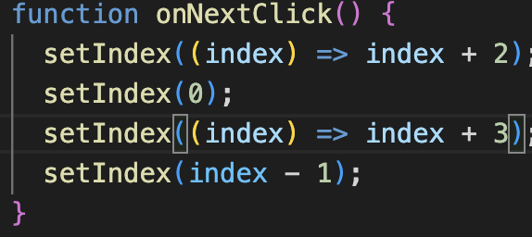
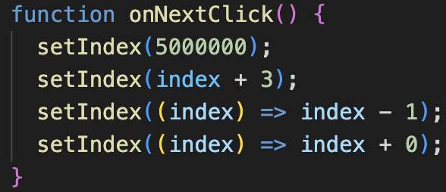
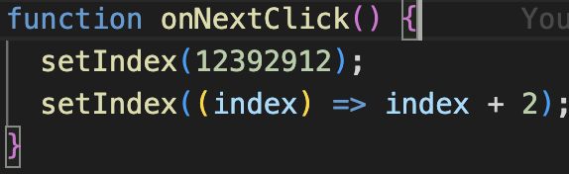
Re-renders | rendering
Now there are other approachs to fulfill the same task… Which one is correct?

Slide 31
React rendering process | Re-renders
React calculates the fastest way to make a change in the DOM
<div />
<div />
root
root
<div />
<div />
Index: 1
<div />
<h1 />
<div />
<h1 />
img
div
div
img
div
div
h1
h2
p
button
h1
h2
p
button

Slide 32

React rendering process | Re-renders
React calculates the fastest way to make a change in the DOM
<div />
<div />
root
root
<div />
<div />
Index: 1
<div />
<h1 />
<div />
<h1 />
img
div
div
img
div
div
h1
h2
p
button
h1
h2
p
button

Slide 33

Browser Paint

Slide 34


Questions?

Slide 35

Thank you
Nicolas Imbachi – Nicolas.ImbachiN@Perficient.com

